Slide 1
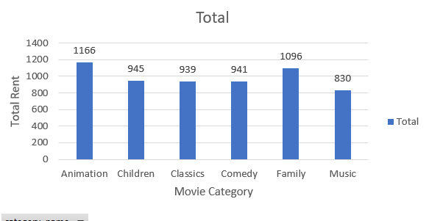
Which Family Movies Category was rented the most ?
<visualization>
From the chart,
we can see that the most rented movie category was Animation
Notes:
/* ----------------------------------------------------------------------------
Query 1 : Which family movies category was watched most?
------------------------------------------------------------------------------*/
/* Create a query consists of 3 colums : film_title, category_name, rental_id */
WITH T1 AS(
SELECT
film.title AS film_title,
category.name AS category_name,
rental.rental_id AS rental_id
FROM category
JOIN film_category
ON category.category_id = film_category.category_id
AND category.name in ('Animation', 'Children', 'Classics', 'Comedy', 'Family', 'Music')
JOIN film
ON film.film_id = film_category.film_id
JOIN inventory
ON inventory.film_id = film.film_id
JOIN rental
ON rental.inventory_id = inventory.inventory_id
)
/*Create a query and create a count of movies and category using Window functions */
SELECT DISTINCT(film_title) AS film_title,
category_name AS category_name ,
COUNT(rental_id) OVER (PARTITION BY category_name ) AS rental_count_category,
COUNT(rental_id) OVER (PARTITION BY film_title) AS rental_count_movie
FROM T1
ORDER BY 2,1

Slide 2
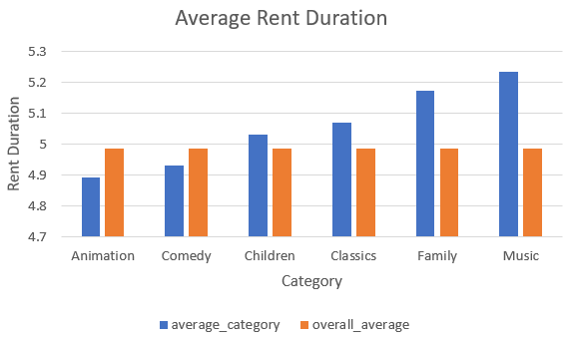
Which Family Movies Categories has average rent duration longer than Overall Average rental duration ?
We can see that Children, Classic, Family and Music Category had average rental duration longer than overall average rental duration
Notes:
WITH T1 AS
(
SELECT film_title AS film_title , name AS name , rental_duration AS rental_duration,
AVG(rental_duration) OVER () AS overall_average,
AVG(rental_duration) OVER (PARTITION BY name) as average_category
FROM (
SELECT film.title AS film_title,
category.name AS name,
film.rental_duration AS rental_duration
FROM category
JOIN film_category
ON category.category_id = film_category.category_id
JOIN film
ON film_category.film_id = film.film_id
) sub
)
SELECT DISTINCT(name) ,average_category, overall_average
FROM T1
WHERE name IN ('Animation', 'Children', 'Classics', 'Comedy', 'Family', 'Music')
ORDER BY 2

Slide 3
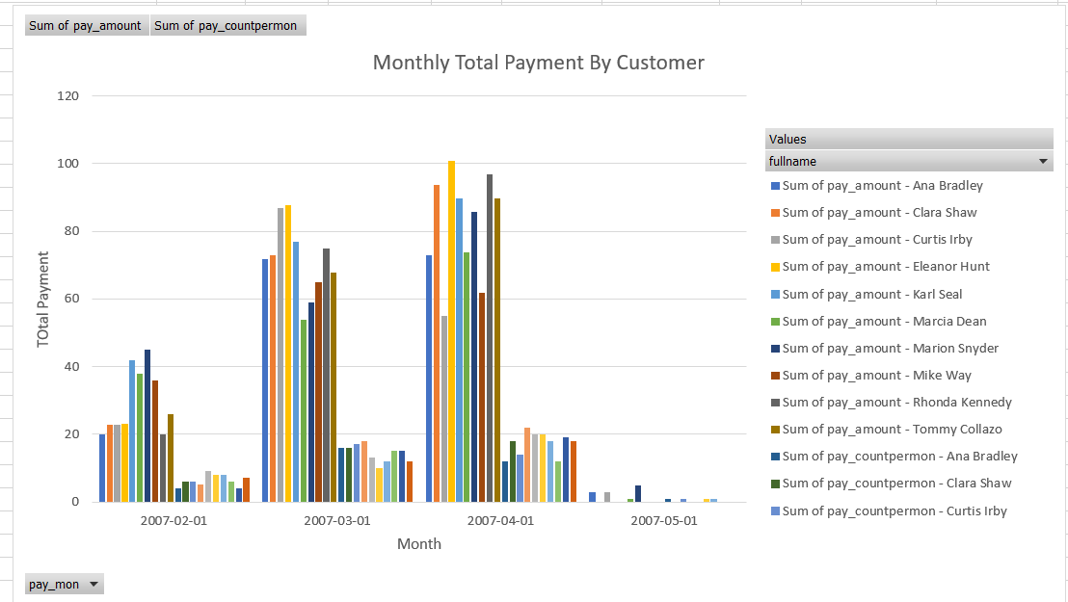
Which month in 2007 where our top 10 paying customers most ?
From the chart,
we can see that our top 10 paying customer made most highest payment on April
Notes:
WITH T1 AS
(
SELECT
DATE_TRUNC('month' , payment.payment_date) AS pay_mon,
CONCAT(customer.first_name , ' ' , customer.last_name) AS fullname,
payment.amount AS pay_amount
FROM payment
JOIN customer
ON payment.customer_id = customer.customer_id
AND DATE_TRUNC('year',payment.payment_date) BETWEEN '2007-01-01' AND '2008-01-01'
),
T2 AS
(
SELECT
pay_mon AS pay_mon,
fullname as fullname,
SUM(pay_amount) AS pay_amount,
COUNT(pay_amount) AS pay_countpermon
FROM T1
GROUP BY 1,2
)
SELECT *
FROM T2
WHERE fullname IN
( SELECT fullname
FROM
(
SELECT fullname AS fullname,
SUM(pay_amount) AS pay_amount
FROM T2
GROUP BY 1
ORDER BY 2 DESC
LIMIT 10
) sub
)
ORDER BY 2,1

Slide 4
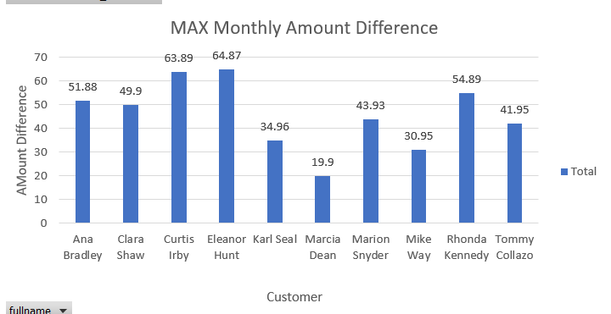
In 2007, What was the biggest monthly difference among our top 10 paying customer?
Eleanor Hunt had MAX monthly amount difference among top 10 paying customer .
The Max monthly difference was $64.87
Notes:
WITH T1 AS
(
SELECT
DATE_TRUNC('month' , payment.payment_date) AS pay_mon,
CONCAT(customer.first_name , ' ' , customer.last_name) AS fullname,
payment.amount AS pay_amount
FROM payment
JOIN customer
ON payment.customer_id = customer.customer_id
AND DATE_TRUNC('year',payment.payment_date) BETWEEN '2007-01-01' AND '2008-01-01'
),
/*create a query and calculate total pay_amount and total count of payment per person*/
T2 AS
(
SELECT
pay_mon AS pay_mon,
fullname as fullname,
SUM(pay_amount) AS pay_amount,
COUNT(pay_amount) AS pay_countpermon
FROM T1
GROUP BY 1,2
),
T3 AS
(
SELECT pay_mon AS pay_mon,
fullname as fullname,
pay_amount AS pay_amount
FROM T2
WHERE fullname IN
(
SELECT fullname
FROM
(
SELECT fullname AS fullname,
SUM(pay_amount) AS pay_amount
FROM T2
GROUP BY 1
ORDER BY 2 DESC
LIMIT 10
) sub
)
ORDER BY 2,1
)
SELECT pay_mon AS pay_mon,
fullname as fullname,
pay_amount AS pay_amount,
pay_amount - LAG(pay_amount) OVER (ORDER BY 1) AS lasthmonth_difference
FROM T3
ORDER BY 2,1

